Slide 1
TrainUP
Online Meeting
Lesson 01 – Simple Present

Slide 2



1 – Obrigatório
2 – Resumo Gramatical – correção de exercícios
3 – Frases
4 – Perguntas
5 – Fluência
6 – Conversation by Topic
7 – Commun Questions

Slide 3
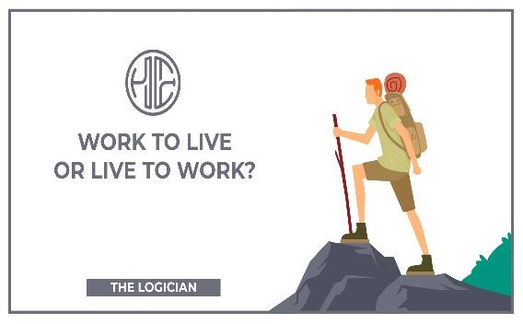
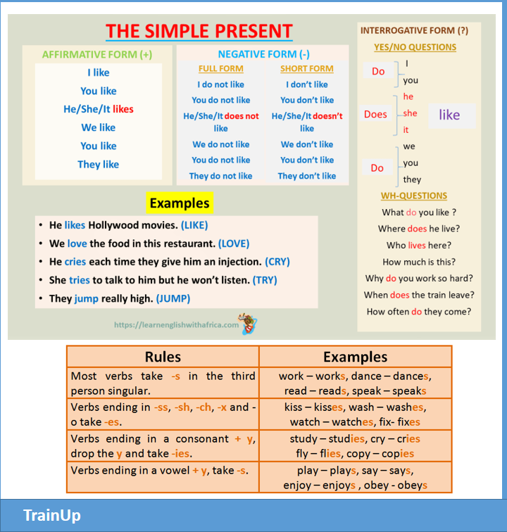

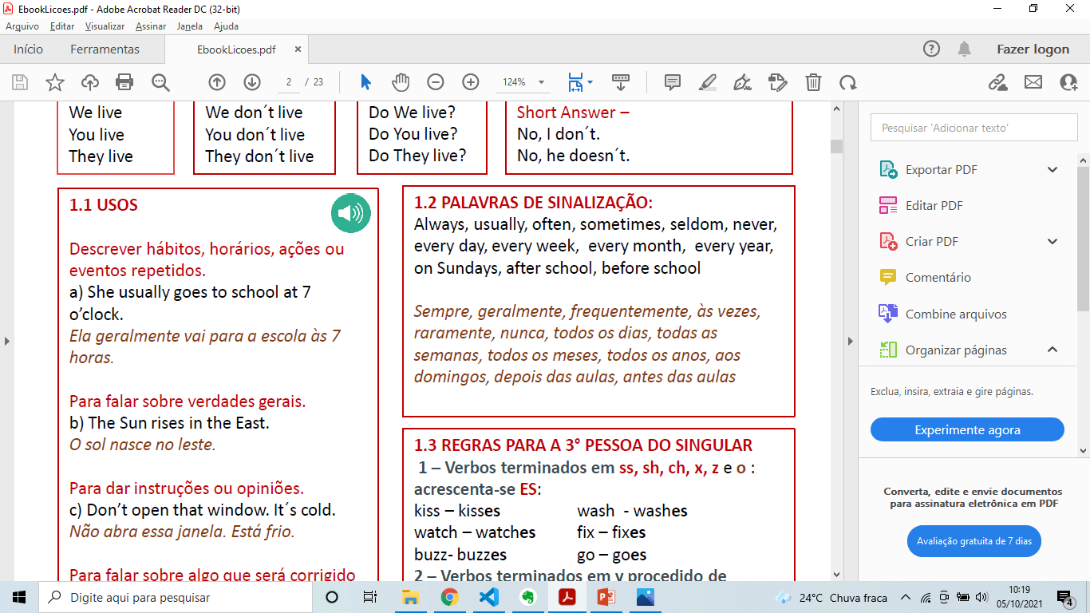


1 – Resumo gramatical

Slide 4
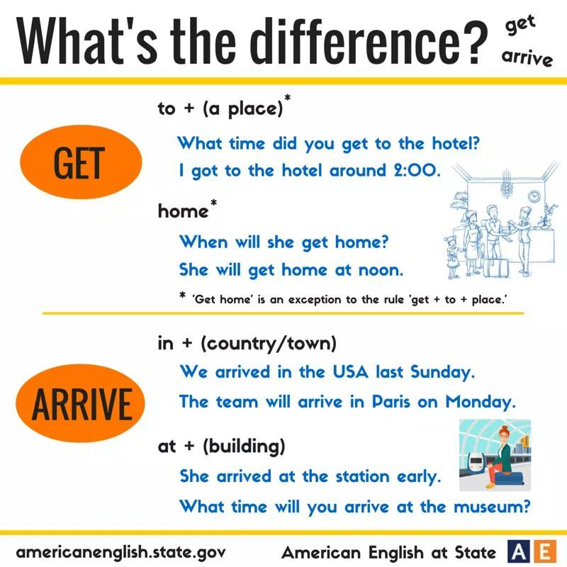

2 - Exercises

Slide 5

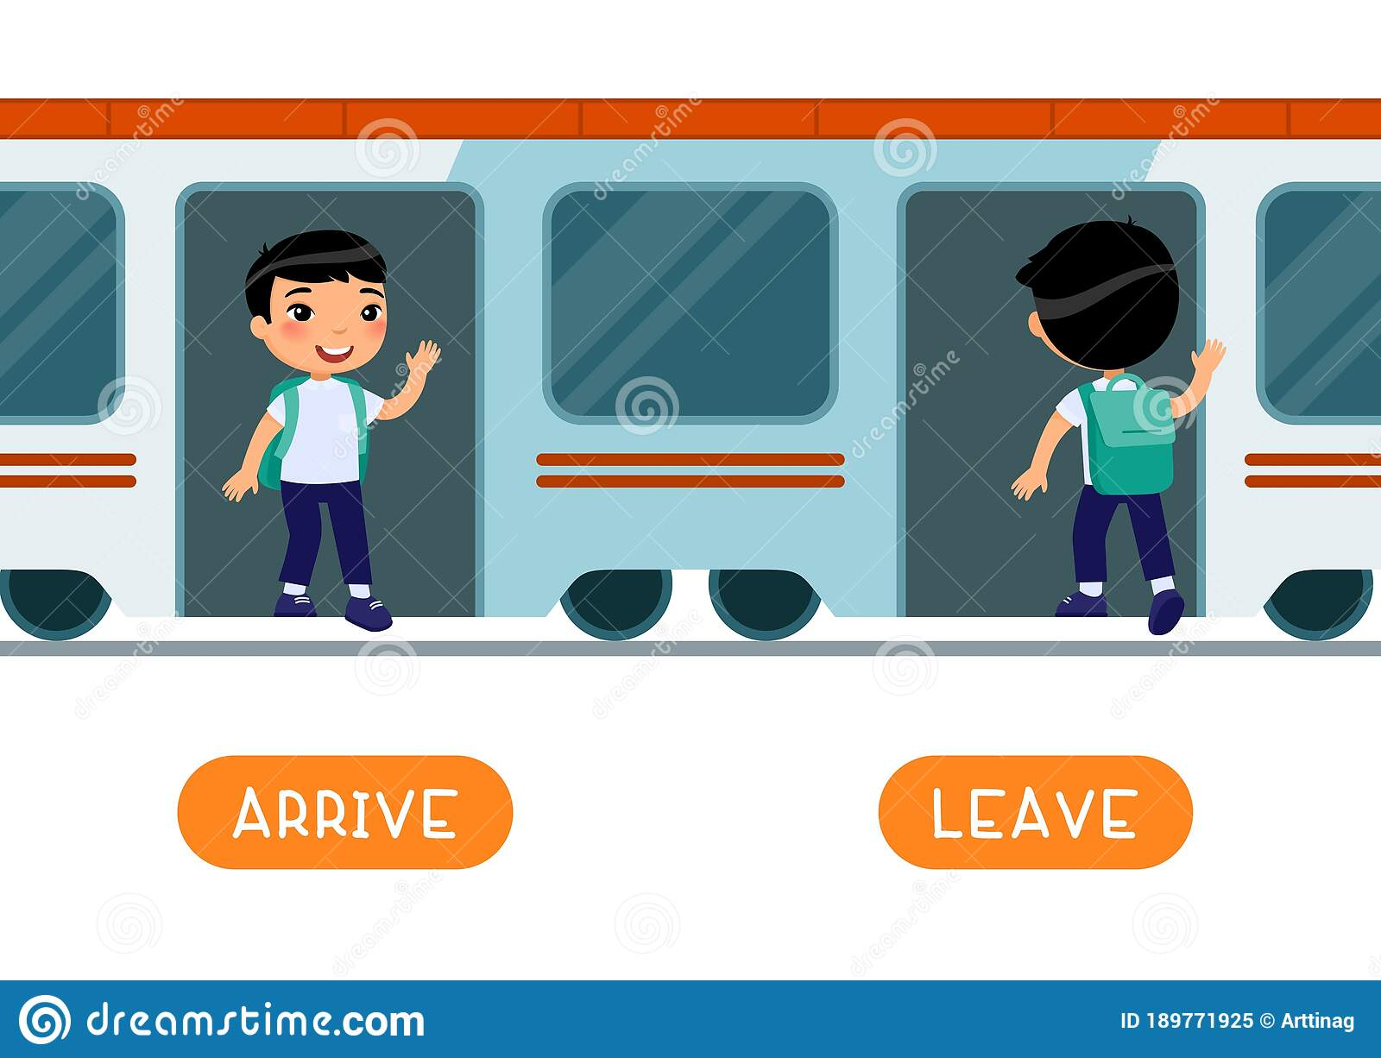

Slide 6

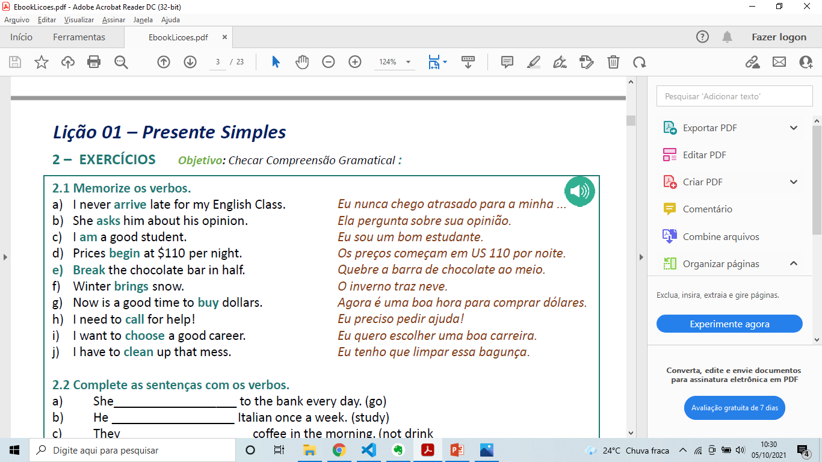

2 - exercises
escolher
comprar
trazer
ligar
quebrar
ser
limpar
começar
chegar
perguntar

Slide 7

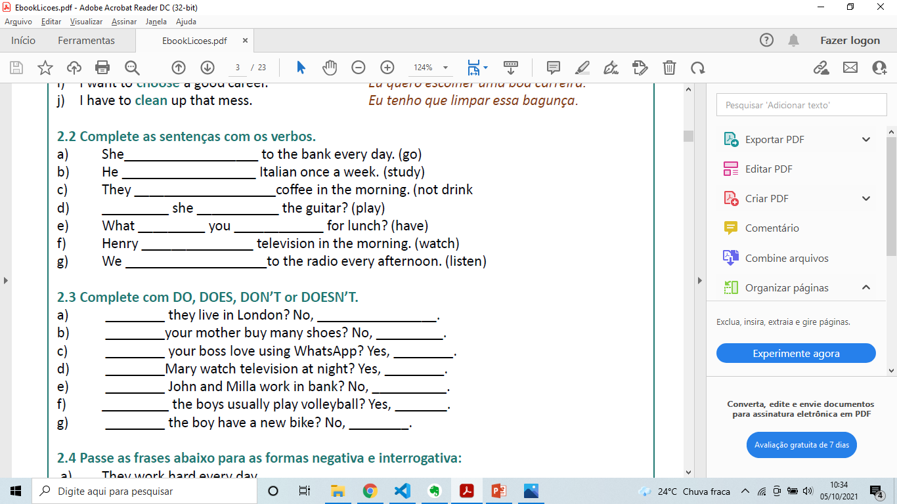
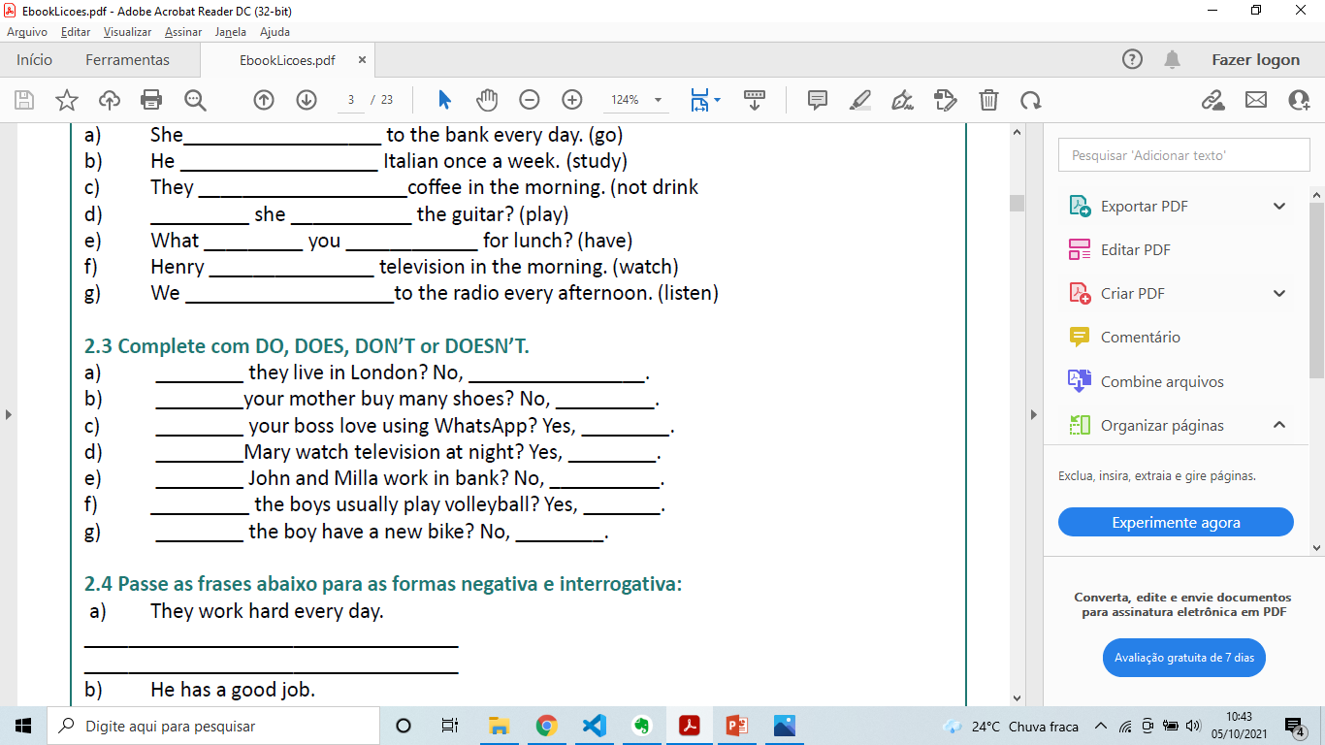

goes
studies
don´t drink
Does
play
do
have
watches
listen
Do
they don´t.
Does
she doesn´t.
Does
he does.
Does
she does.
Do
they don´t.
Do
they do
Does
he doesn´t.

Slide 8
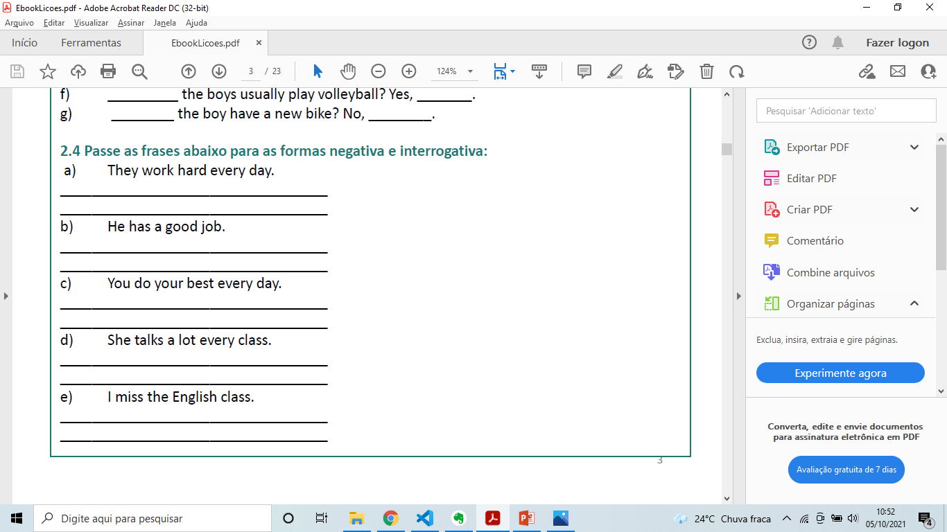




They don´t work hard every day.
Do they work hard every day?
He does not have a good job.
Does he have a good job?
You don´t do your best every day.
Do you do your best every day?
She doesn´t talk a lot every class?
Does she talk a lot every class?
I don´t miss the English class.
Do I miss the English class?

Slide 9

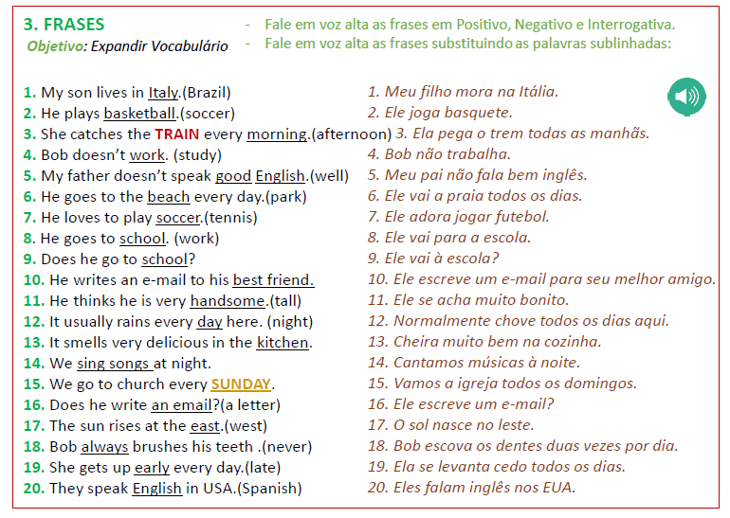

3 - Frases

Slide 10

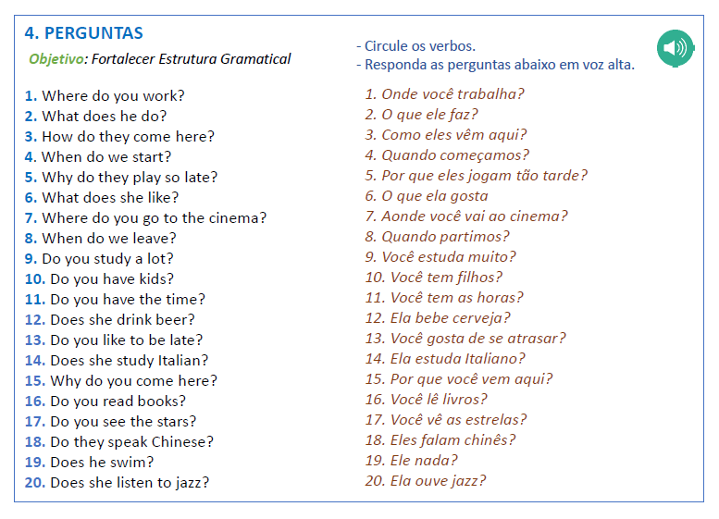

4 - perguntas

Slide 11
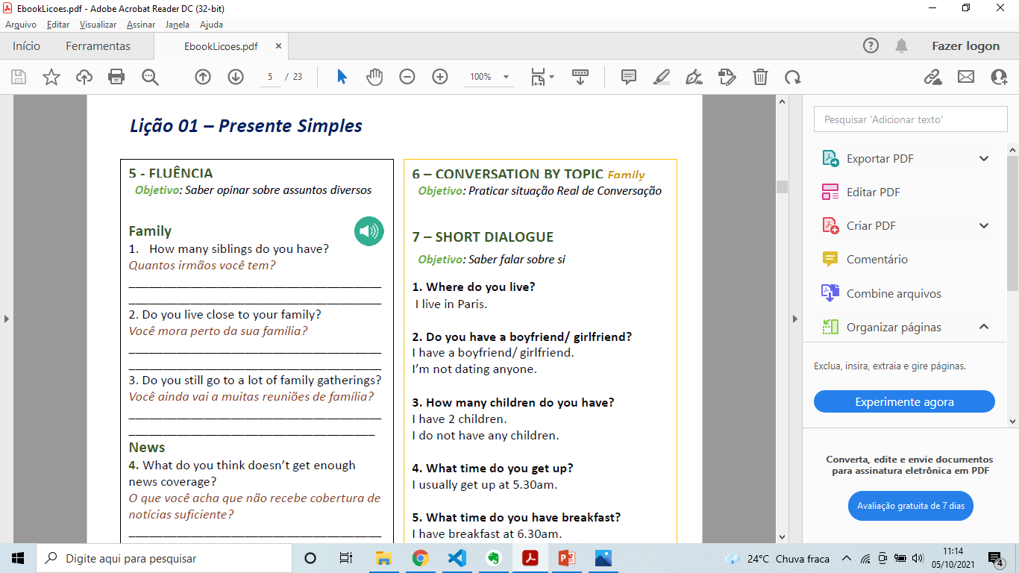
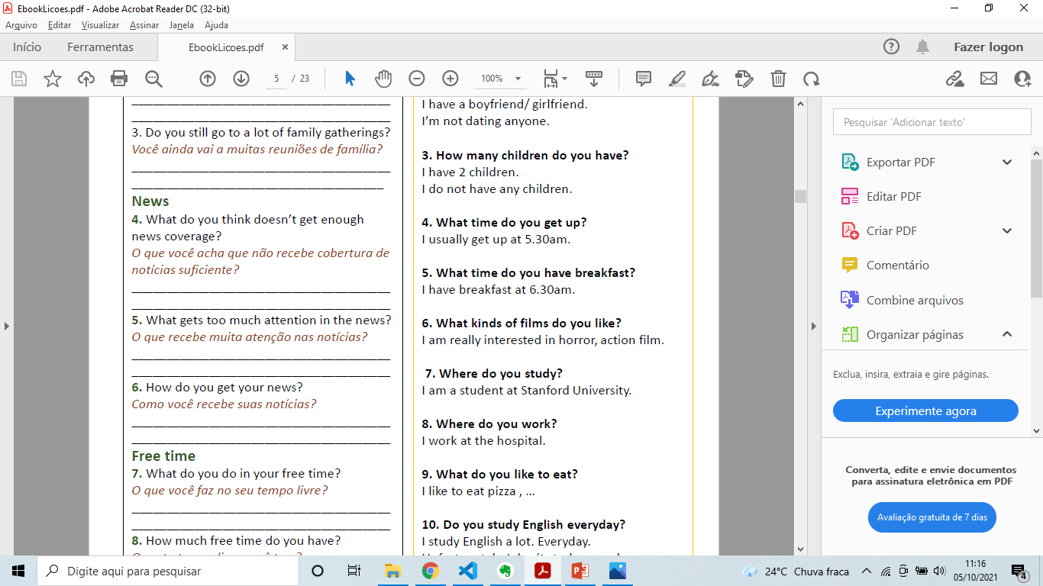
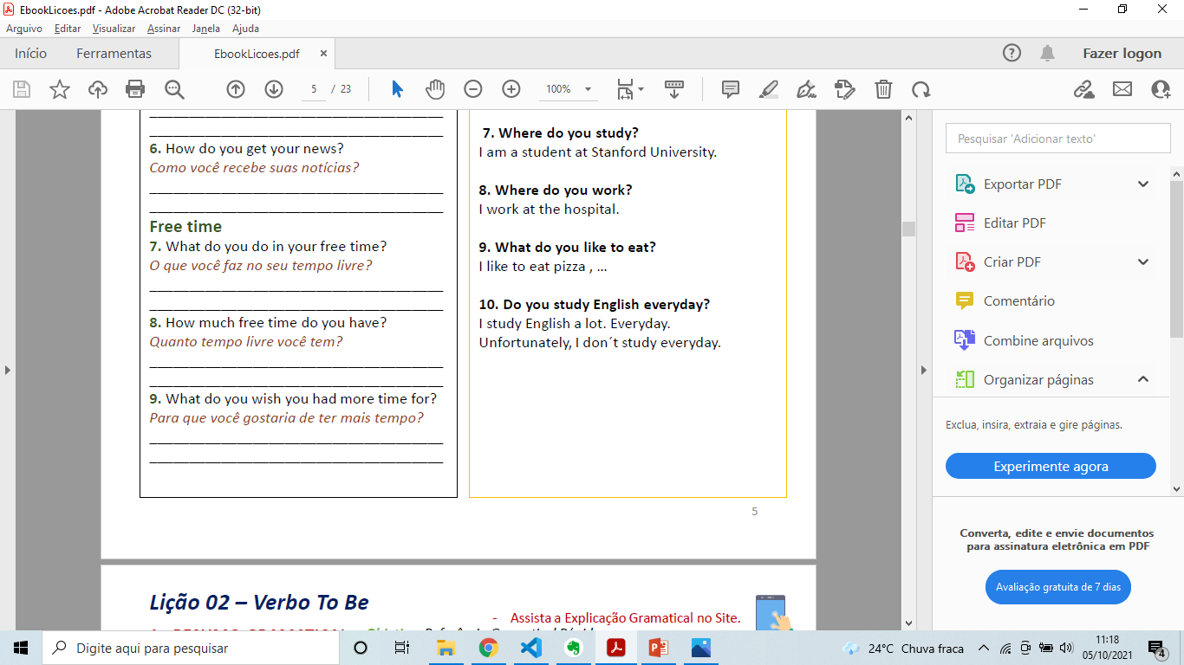



5 - fluência

Slide 12

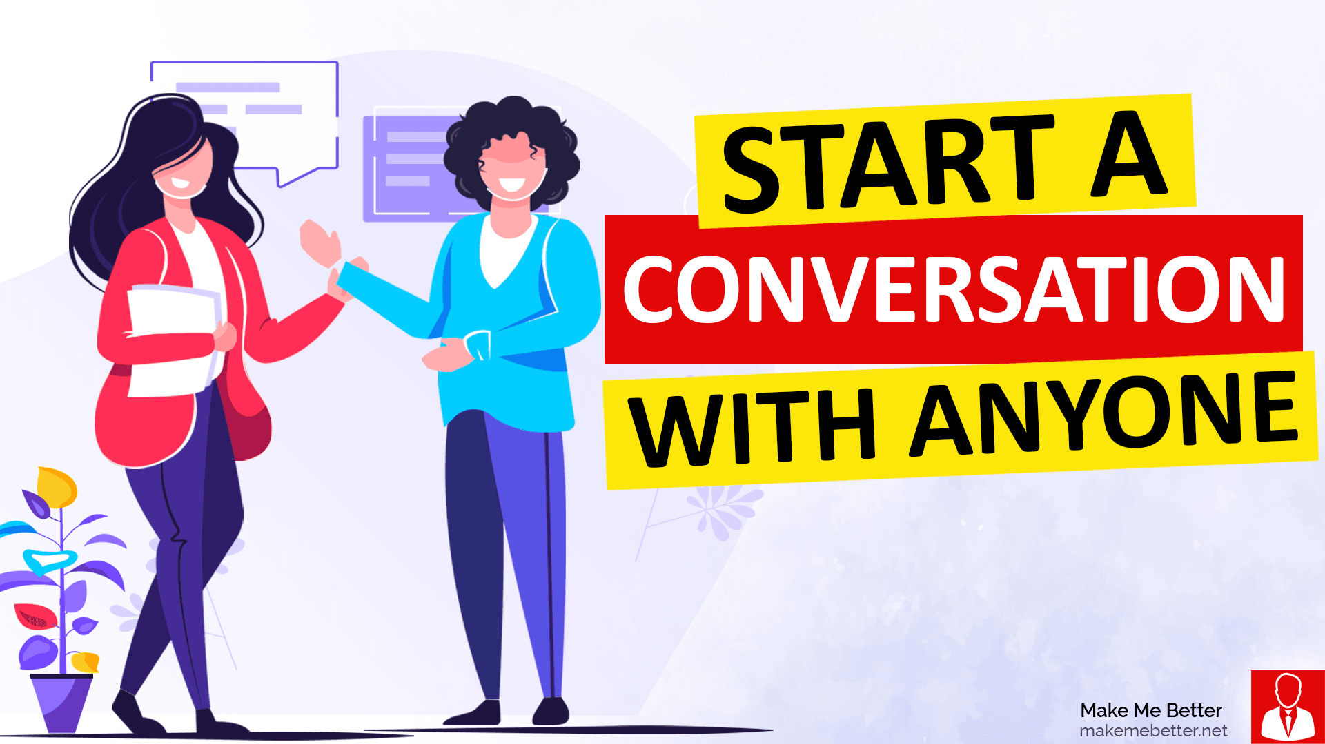



6 – conversation by topic

Slide 13



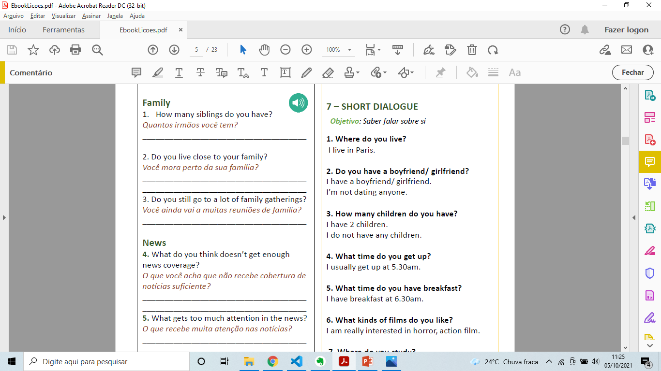
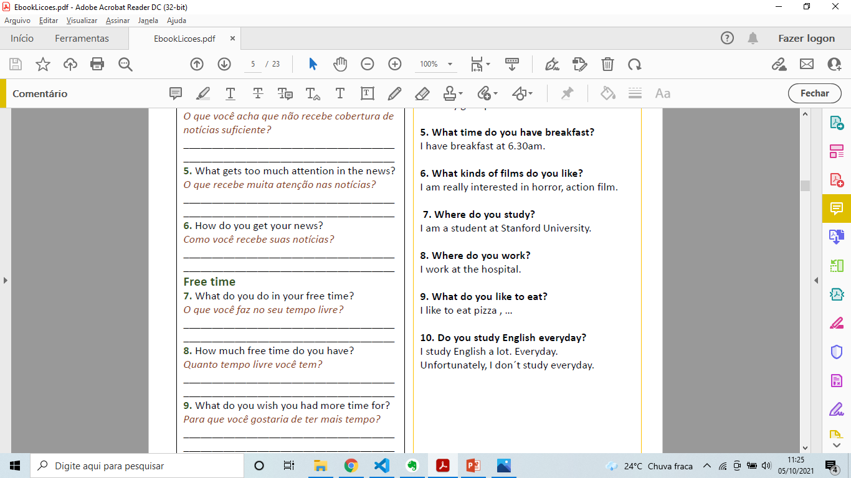
7 – short dialogue

Slide 14
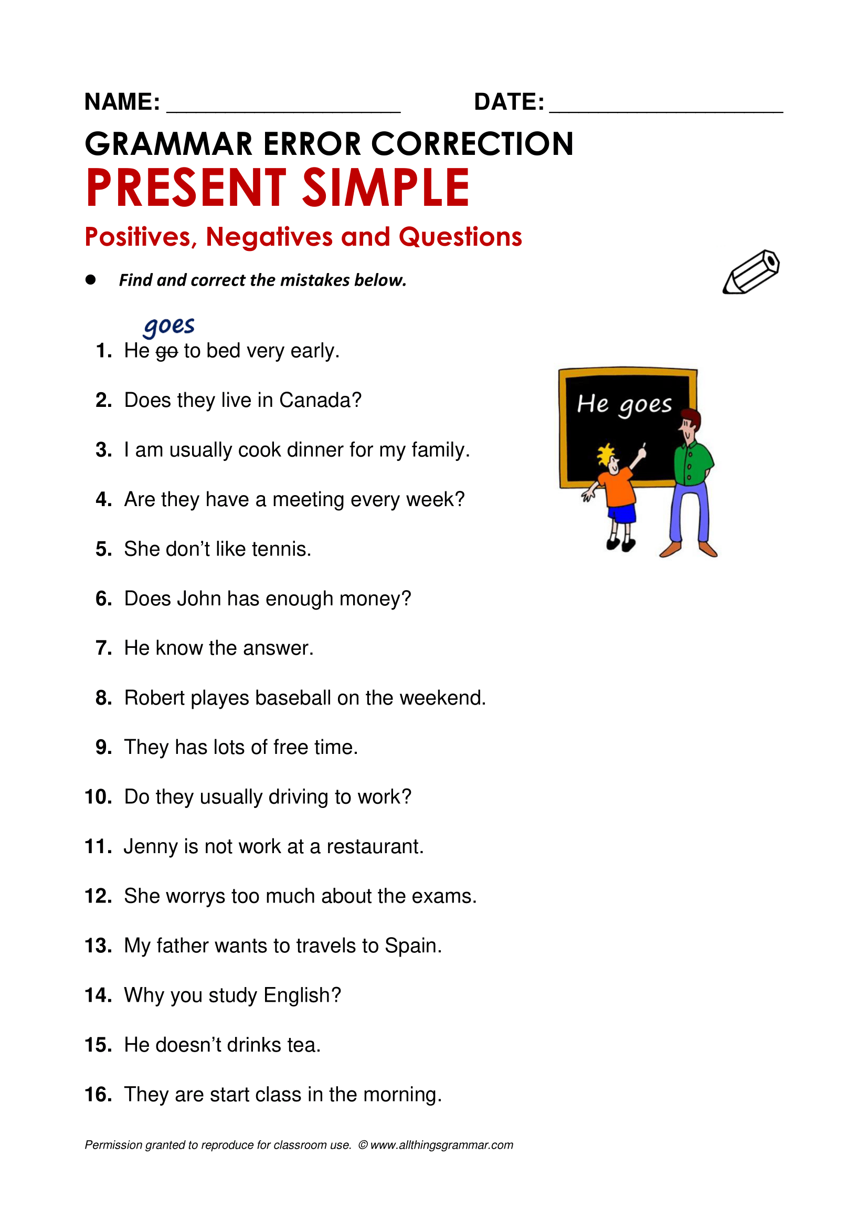
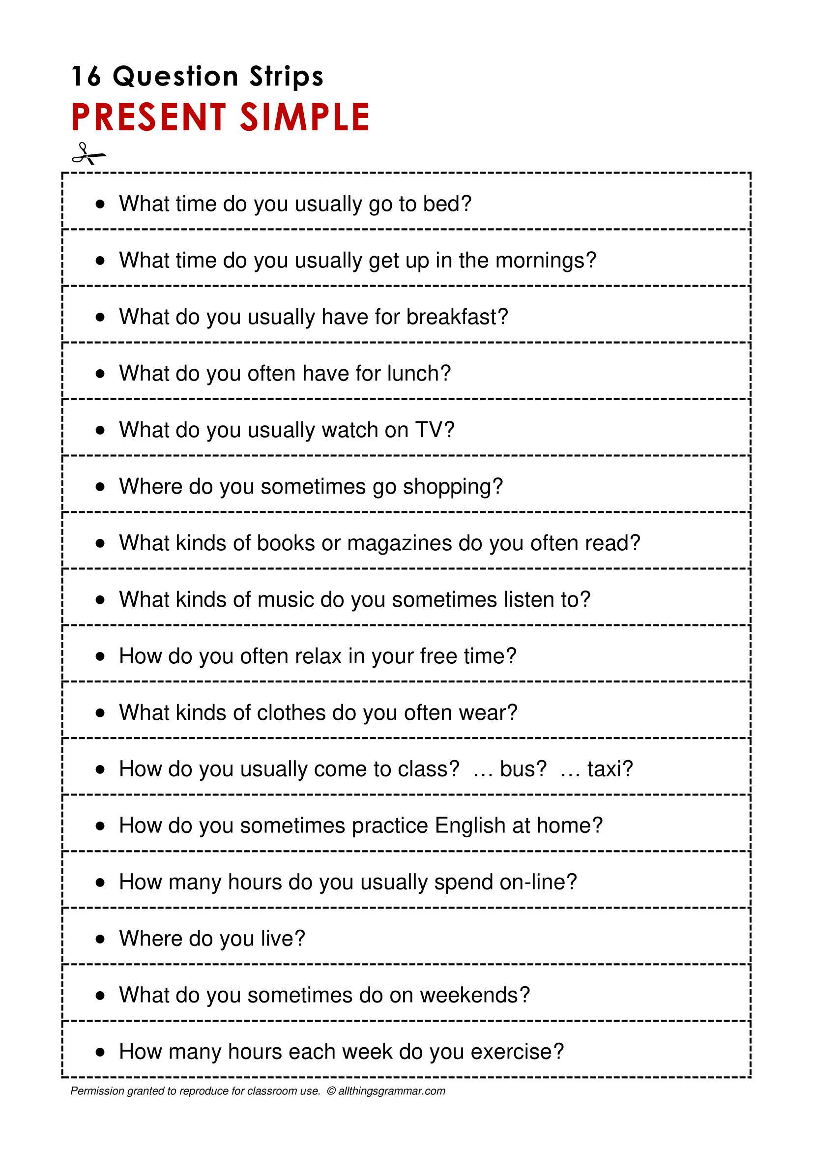

Slide 15
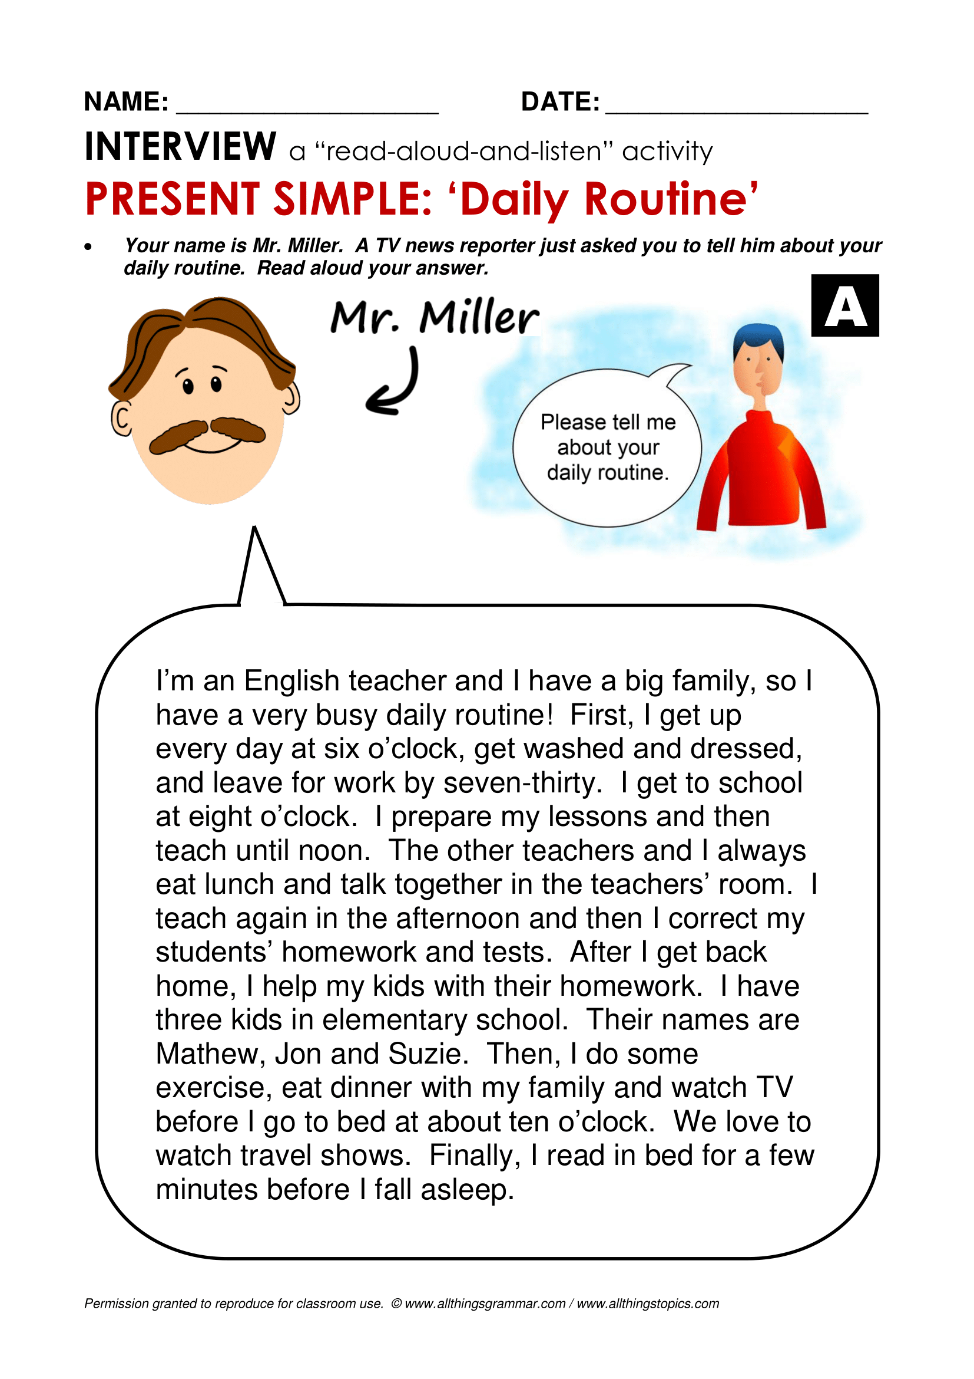
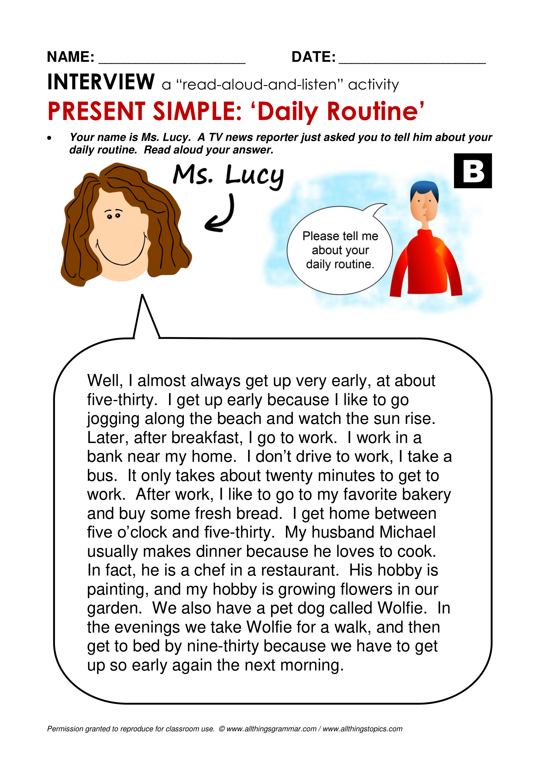

Slide 16


TrainUP
Online Meeting
Lesson 01 – Simple Present

